Slide 1
Md. Ashikur Rahman Batch _09 Roll : 14

Slide 2
A SEMINAR ON
Salinity-persuaded loss and damage to farming
households in coastal Bangladesh.

Slide 3
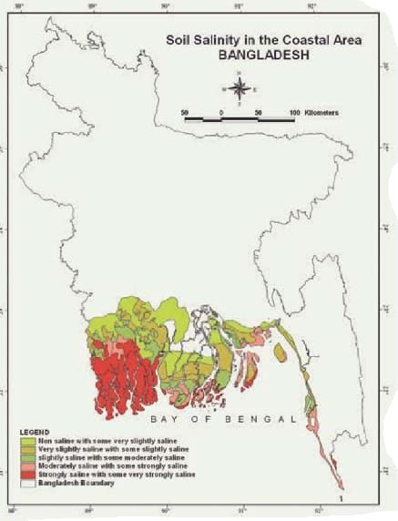
Soil Salinity in Coastal Areas

Slide 4
Content
Introduction
Causes of Salinity Problem
Statement of the problem
Objective of the study
Impact
Result and Discussion
Recommendation

Slide 5
Introduction
Agriculture is a major sector of Bangladesh’s economy and the coastal area of Bangladesh is very fertile for growing rice. Increase in salinity intrusion and increase in soil salinity will have serious negative impacts on agriculture.
A study was carried out in four villages within twounions1 at Shyamnagar Upazilla (sub-district) in Satkhira District in order to comprehend the relationship between salinity intrusion and rice production, how people are adapting, and whether adaptation measures are sufficient to avoid adverse climate-change impacts.

Slide 6
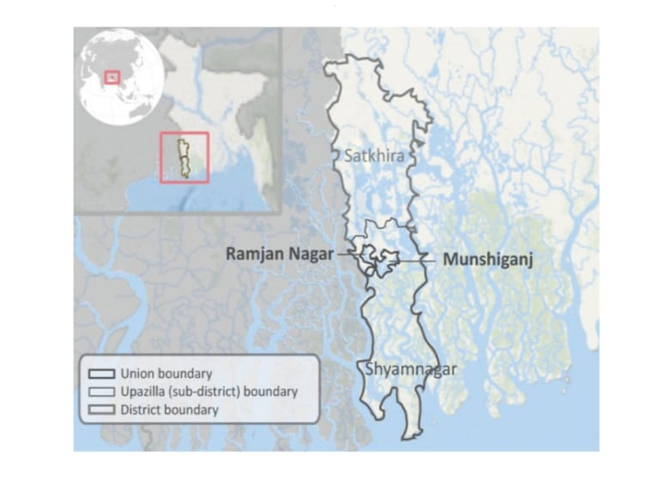
A study was carried out in four villages within two unions1 at Shyamnagar Upazilla (subdistrict) in Satkhira District in order to comprehend the relationship between salinity intrusion and rice production, how people are adapting, and whether adaptation measures are sufficient to avoid adverse climate-change impacts

Slide 7
The district has a population of about 2.2 million people and a land area of 3,858 km2 (BBS, 2008). Seven sub-districts (upazilla in Bengali), including Shyamnagar, make up the district, which has 78 unions and Kobadak, Sonai, Kholpatua, and Kalindi are the principal rivers.
Agriculture, fishing, pisci culture, and other related industries provide the most frequent livelihoods (Banglapedia, 2003). Rice (aus, 2 aman3, and boro4), wheat, jute, sugarcane, and vegetables are the principal crops of Satkhira District

Slide 8
People of the study area are converting their agricultural land to shrimp farming because of salinity impact.
The impact of salinity on crop production is already visible in the study area. Maximum people of the study area are engaging with shrimp farming which percentage is 61% and some are baby prawn collection which percentage is 18%. About 10% of people have no plan and 72% men want to shrimp firming

Slide 9
Causes of Salinity Problem
Critical Geographical Location of the Country
Sedimentation
Sea Level Rise
Cyclone and Storm Surge
Tidal Flooding
Changes in Ground Water Flow
Continuous Shrimp Cultivation in Agricultural Land
Weak Structure and Poor Maintenance
Anthropogenic Climate Change Induced Factors
Weak Water Governance Systems at Local Level
Structural Intervention in Upstream Neighboring Country

Slide 10
Statement of the problem
Loss and damage associated with climate change and variability.
Severe impact on agricultural productivity caused by salinity
intrusion.
Salinity intrusion in fresh water.
Salinity intrusion into the agricultural field.
Salinity intrusion into soil.

Slide 11
Objective of the study
Understanding the interaction of salinity intrusion and rice production.
Understanding, how the people are adapting and whether adaptation measures enough to avoid adverse climate-change impacts.
Understanding estimated the loss and damage in rice production caused by salinity intrusion.
Understanding the arable land affected by salinity intrusion.
Understanding the cultivated agricultural rice field affected by the salinity intrusion.

Slide 12
Impact
Soil Salinity
Water quality
Farming practices
Tree production
Food safety
Cropping system
Environmental adversities

Slide 13
Results and Discussions
According to the BBS, Satkhira's net cultivated area shrunk by around 7% between 1996 and 2008. (BBS, 2008). It was discovered that the amount of rice produced overall in Satkhira fell from 0.53 million tons in 2008 to 0.46 million tons in 2009 immediately following typhoon Aila (BBS, 2009, 2010). Additionally, according to the research, Satkhira's production of the main rice crop (aman rice) significantly declined from roughly 0.3 million tons in 2008 to 0.2 million tons in 2010.

Slide 14
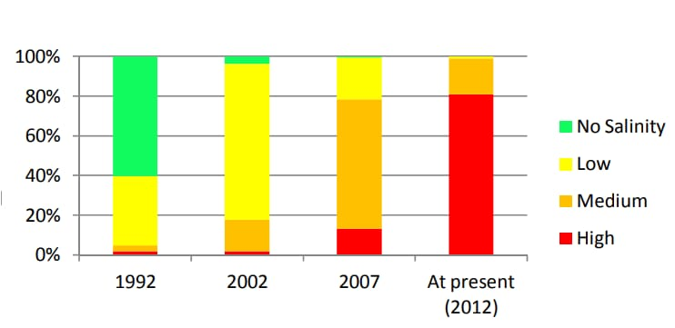
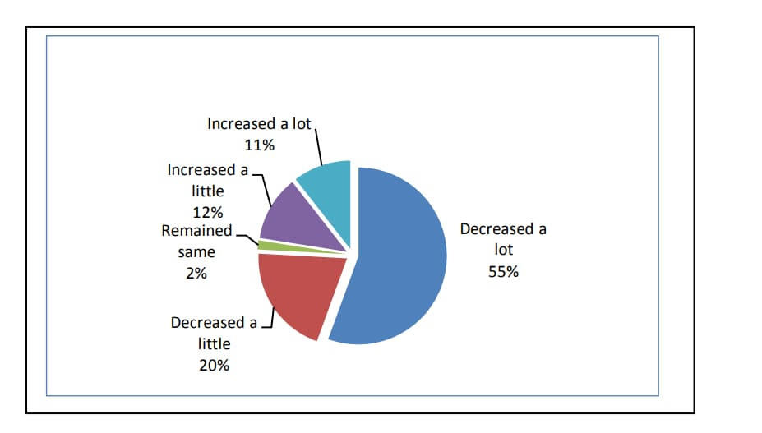
Trend of salinity in last 20
years
Change of rice production in
last 20years

Slide 15
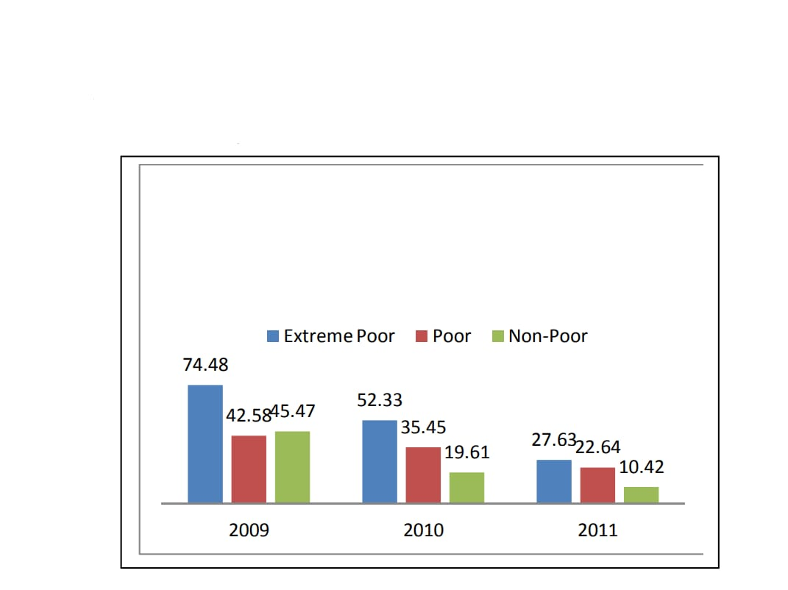
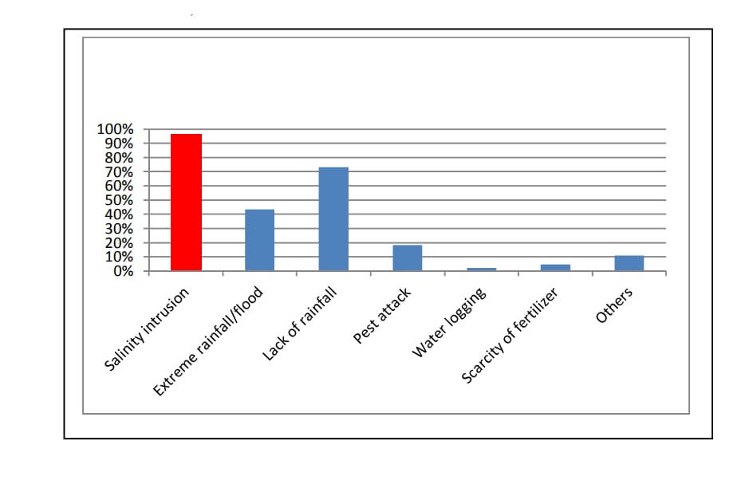
Percentage of respondents on causes of reduction in rice production
Value of loss (as % of household annual income) due to decrease in rice production caused by cyclone Aila induced saline intrusion
.

Slide 16
In Bangladesh, rice production may fall by 10% and wheat by 30% (within 2050) that is our main agricultural product.
It is now important to rethink long-term planning for rice cultivation in the coastal zone, not only in areas currently affected by saline intrusion but also in areas that could potentially be affected, according to predicted climate scenarios. Low-lying agricultural land needs to be securely protected, while at the same time innovative and context specific practices, including climate-resilient rice cultivation (seeds and methods), must be researched and implemented.

Slide 17
Recommendations
Conjunctive use of fresh and saline water
Shallow water table management
Selection of salt tolerant crops
Massive awareness at the local level regarding water resource, its use and management.
Construction/repair/redesign of embankments along the coast.

